Slide 1

UNIVERSITY ENTRANCE EXAM ELIGIBILITY FORM
Submitted by:
ANKITA SINGH
ASHUTOSH ANAND SHARMA
NIKHIL PATHANIA
SARTHAK SRIVASTAVA

Slide 2

CONTENTS
INTRODUCTION
OBJECTIVE
ADVANTAGES OF PROPOSED PROJECT
APPLICATION TOOLS USED
FRONTEND ( HTML , CSS , SUBLIME TEXT )
BACKEND ( PHP , MY SQL , XAAMP )
SNAPSHOTS
CONCLUSION
ABOUT GROUP MEMBERS

Slide 3

INTRODUCTION
This project is designed so as to be used by the University for the Admission Purposes.
Through this website the user or the candidate can view all the necessary information regarding the University and it is a type of Small Educational Website.
The main objective of our website is to gather all the information of the candidate and to verify their eligibility criteria by filling an eligibility form.
As the candidate enters all the details in the form and clicks the submit button , his/her data will be automatically stored at the backend database for verification purpose.

Slide 4

OBJECTIVES
Our objective is to design and create a university website .
First of all we will have our home page in which we have the overview and brief information about the university.
Our main objective is the filling of eligibility form by the students and verifying their eligibility for admission purpose.
After entering all the information in the form , when user will click SUBMIT button , the will be stored at the backend into our database .

Slide 5

ADVANTAGES OF PROPOSED PROJECT
If any student wants to take admission into our university , he/she can visit the site.
There ,one can get the whole overview about the university.
Interested candidates can fill the eligibility form available at the website for the verification of the eligibility for admission purpose.
The website is so easy to use that everyone can use it.

Slide 6

APPLICATION TOOLS USED
HTML
CSS
PHP
MY SQL
XAAMP
SUBLIME TEXT

Slide 7

FRONTEND
HTML
HTML stands for Hyper Text Markup Language. It is the standard markup language for creating Web pages. It describes the structure of a Web page. It consists of a series of elements. HTML constructs images and other objects such as forms and are delineated by tags which means written using angle brackets.

Slide 8

FRONTEND (contd.)
CSS
CSS stands for Cascading Style Sheets. CSS describes how HTML elements are to be displayed on screen, paper, or in other media. CSS saves a lot of work. It can control the layout of multiple web pages all at once. External Style Sheets are stored in CSS files.
(CSS) is designed to enable the separation of the presentation and the content, including layout, colors and fonts.

Slide 9

FRONTEND (contd.)
SUBLIME TEXT
Sublime Text is a shareware cross-platform source code editor with a Python application programming interface. It natively supports many programming languages and markup languages, and functions can be added by users with plugins, typically community-built and maintained under free-software licenses

Slide 10

BACKEND
PHP
PHP is a general purpose scripting language especially suited to web development. It was originally created by Danish-Canadian programmer “Rasmus Lerdorf” in 1994. PHP originally stood for the Personal Home Page but now it stands for the recursive initialism.

Slide 11

BACKEND (contd.)
MY SQL
SQL is a standard language for accessing and manipulating databases. SQL stands for Structured Query Language. SQL lets you access and manipulate databases. SQL became a standard of the American National Standards Institute (ANSI) in 1986, and of the International Organization for Standardization (ISO) in 1987 SQL can execute queries against a database, retrieve data, insert records in a database, update records, delete records, create new databases, create new tables in a database, create stored procedures in a database, create views in a database, set permissions on tables, procedures, and views

Slide 12

BACKEND (contd.)
XAAMP
XAMPP is a free and open-source cross-platform web server solution stack package developed by Apache Friends, consisting mainly of the Apache HTTP Server, MariaDB database, and interpreters for scripts written in the PHP and Perl programming languages.

Slide 13
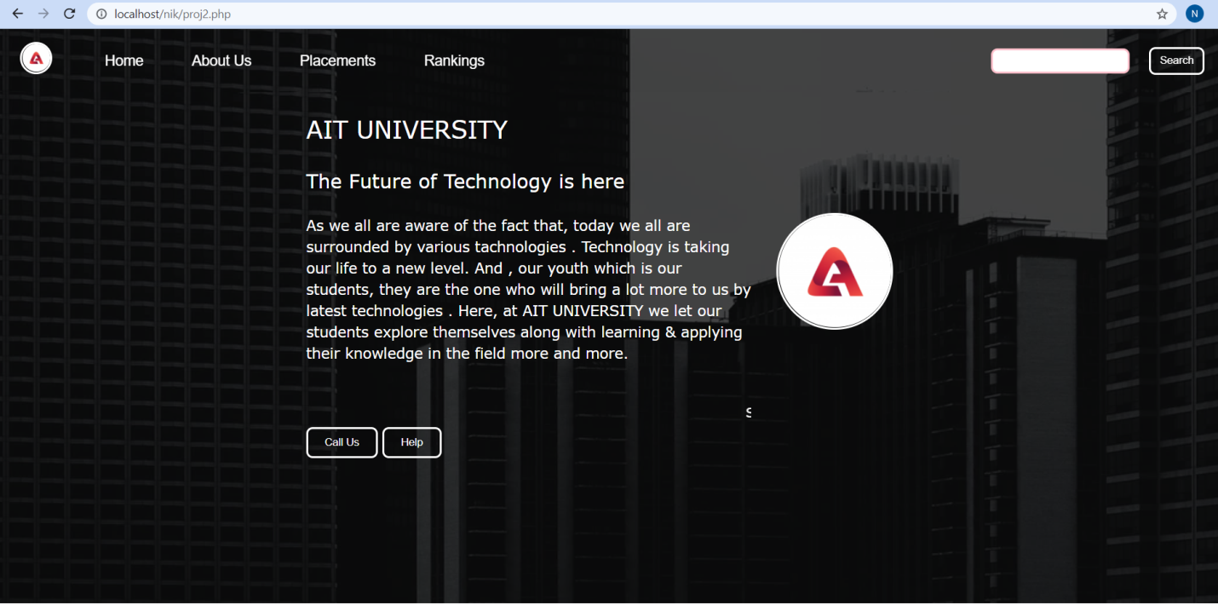
SNAPSHOTS OF WEBSITE
HOME PAGE

Slide 14
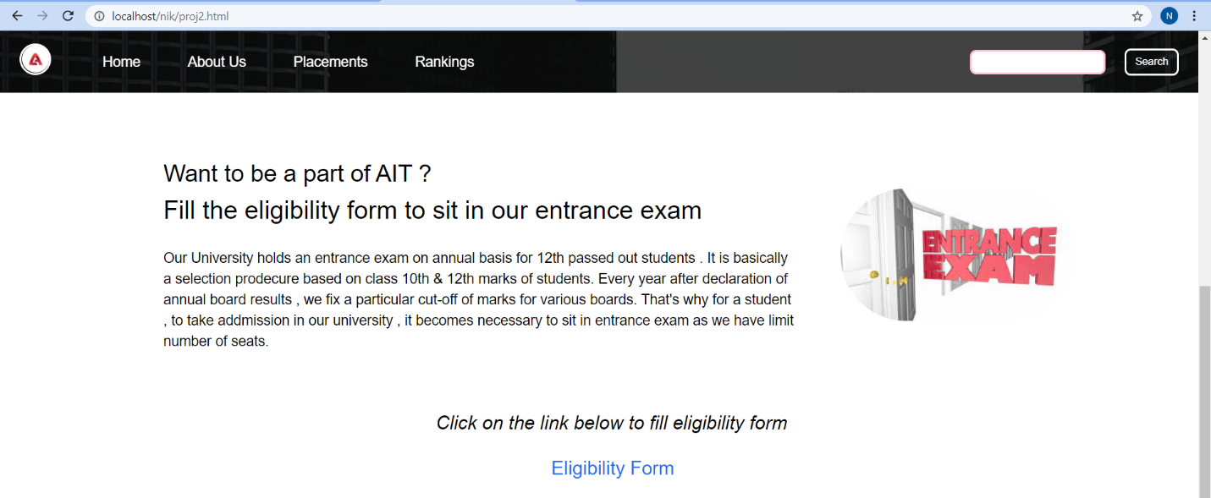
SNAPSHOTS (contd.)
HOME PAGE (CONTD.)

Slide 15

SNAPSHOTS (contd.)
HOME PAGE (contd.)

Slide 16

SNAPSHOTS (contd.)
AFTER CLICKING LOGO OF UNIVERSITY

Slide 17
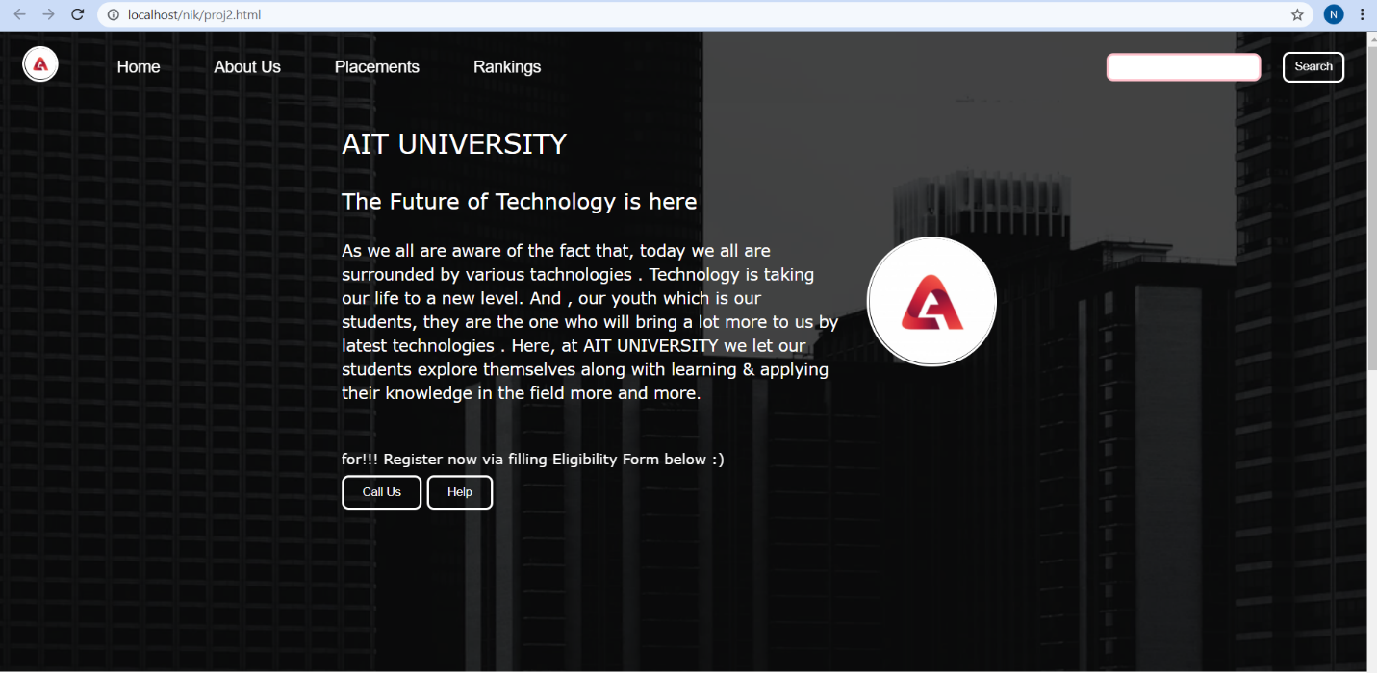
SNAPSHOTS (contd.)
AFTER CLICKING HOME

Slide 18
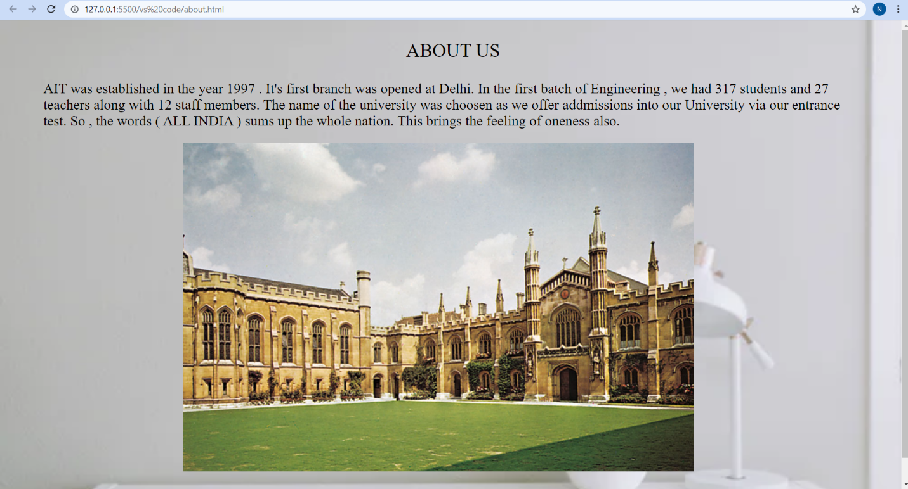
SNAPSHOTS (contd.)
AFTER CLICKING ABOUT

Slide 19
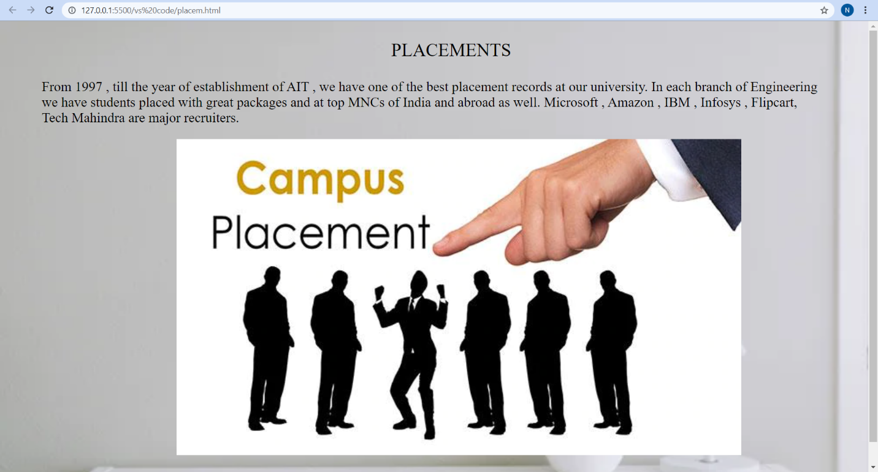
SNAPSHOTS (contd.)
AFTER CLICKING PLACEMENTS

Slide 20
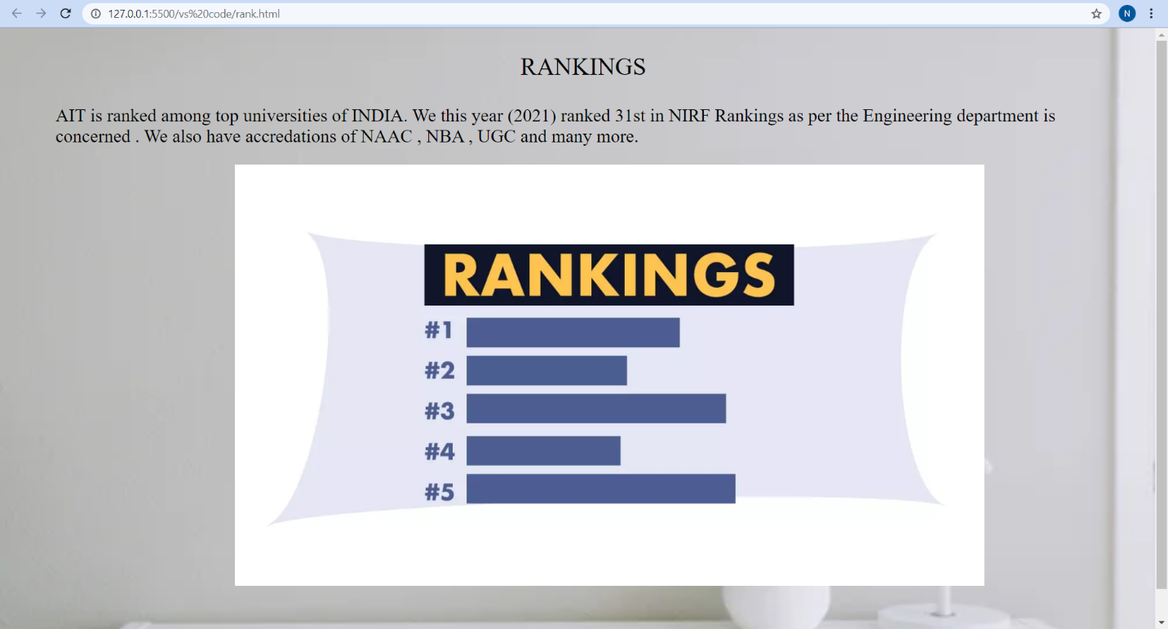
SNAPSHOTS (contd.)
AFTER CLICKING RANKINGS

Slide 21
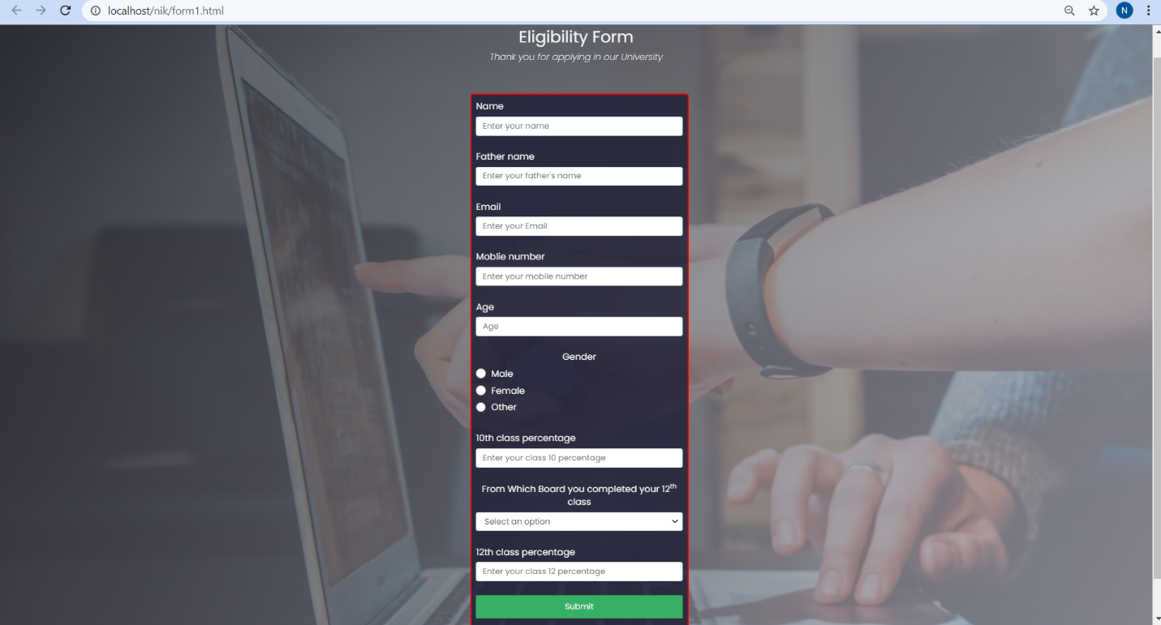
SNAPSHOTS (contd.)
REGISTRATION FORM

Slide 22
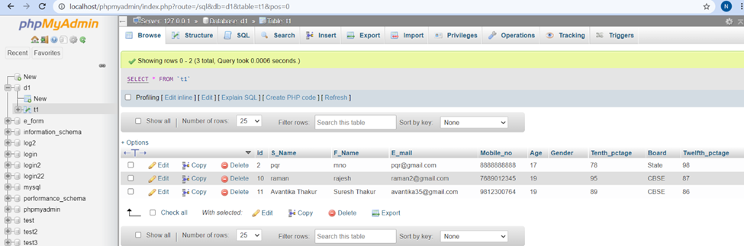
SNAPSHOTS (contd.)
BACKEND DATABASE

Slide 23

CONCLUSIONS
Our project will mainly give candidate a brief overview about the university.
He/ she can explore various sections in our website regarding information of the university .
The objective will be accomplished after the filling of eligibility form by the candidate and his/her information will be stored at backend database.
He/she will be notified after verifying his/her eligibility for admission purpose via their registered email address .

Slide 24
GROUP MEMBERS
S.NO | NAME | UID
1 | ANKITA SINGH | 20BCS5504
2 | ASHUTOSH ANAND SHARMA | 20BCS5512
3 | NIKHIL PATHANIA | 20BCS5517
4 | SARTHAK SRIVASTAVA | 20BCS5482

Slide 25

.

